Slide 1
Pat Connelly
GPS Clock

Slide 2
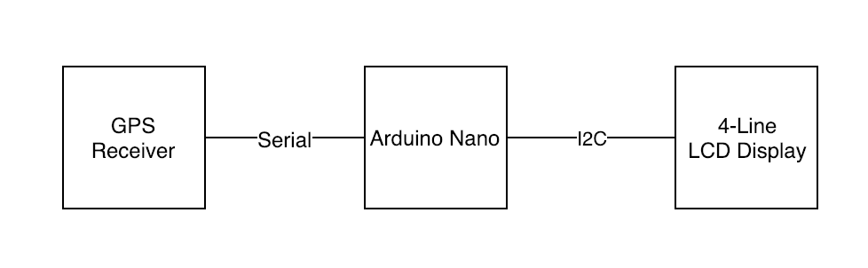
Components
Arduino Nano –(knockoff)
GPS receiver
LCD Panel
Switch

Slide 3
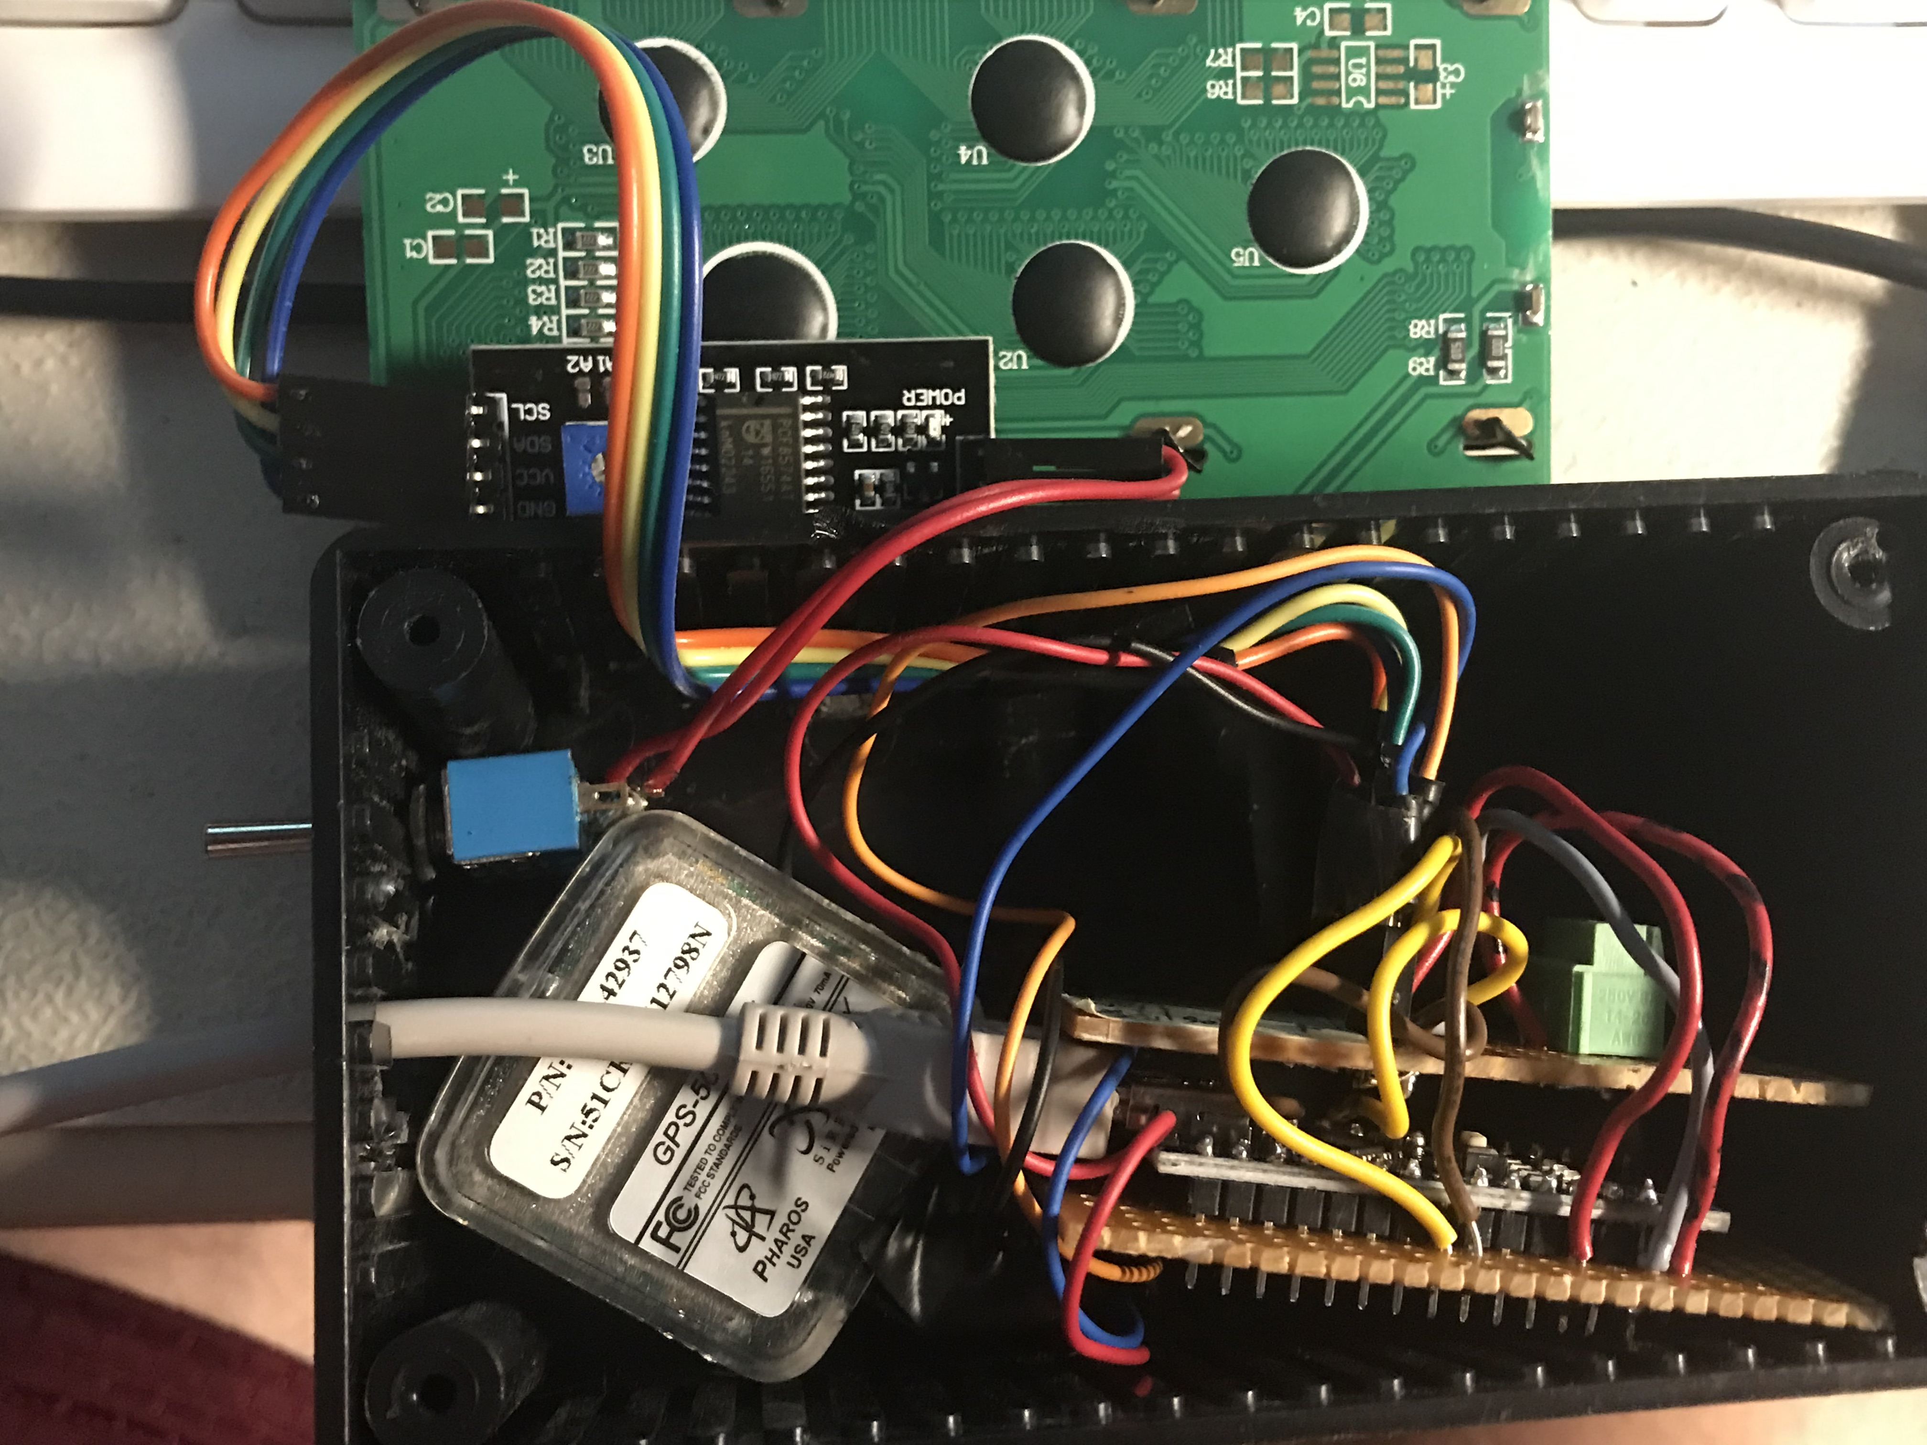

Slide 4
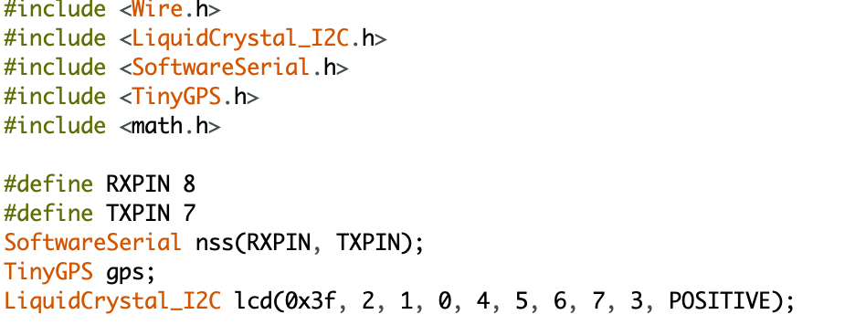
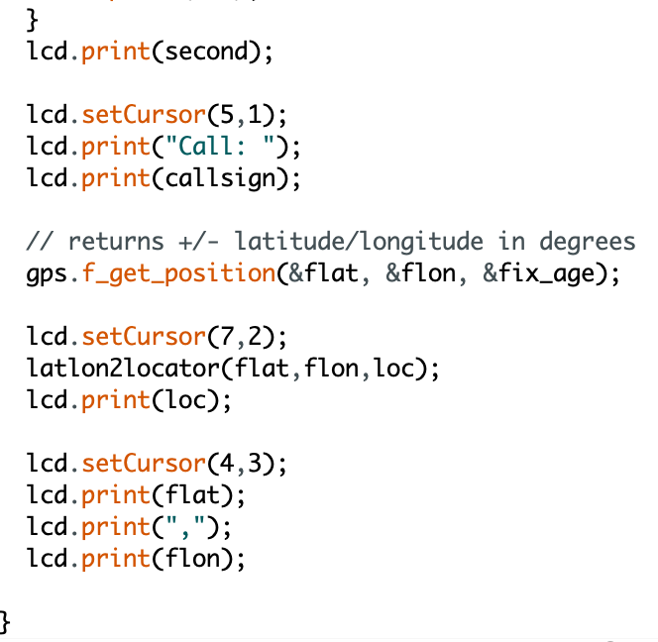
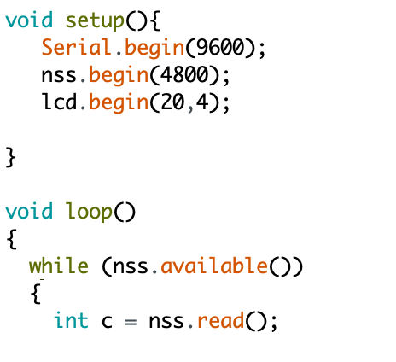
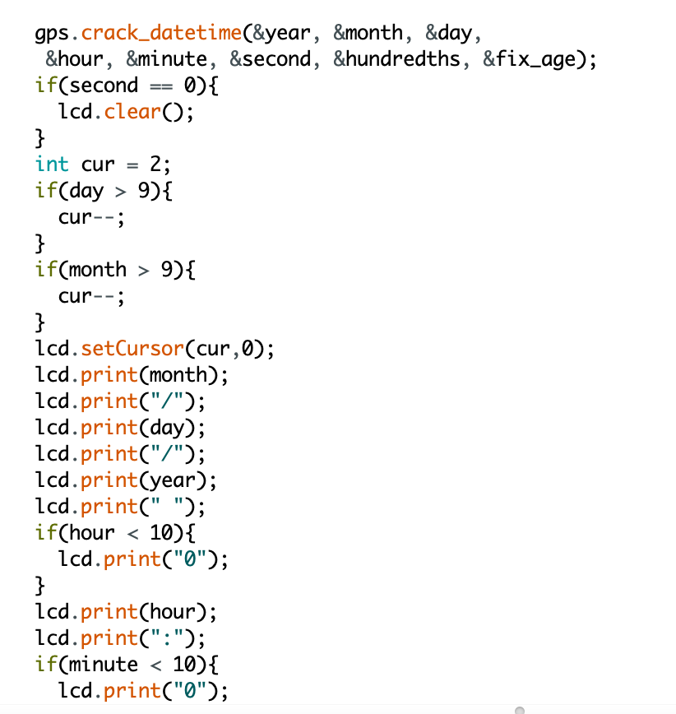
Code

Slide 5
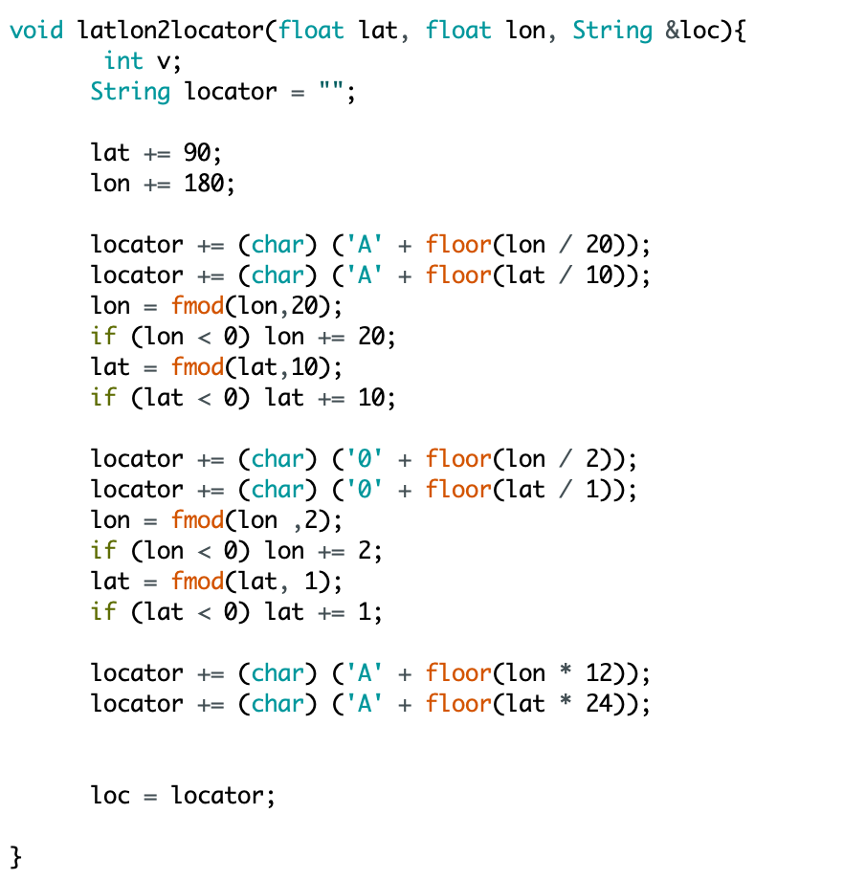
Lat/Lon -> Grid Square function

Slide 6
Thanks
Amateur radio blog: https://aa0o.radio
May 3rd SPARC Club meeting
– Parks on the Air Presentation

